Slide 1



Toward a Gauge Theory of
Musical Forces
Quantum Interaction 2016
SFSU, San Francisco, July 20—22, 2016.
Peter beim Graben
Bernstein Center for Computational Neuroscience Berlin
Reinhard Blutner
Universiteit van Amsterdam

Slide 2
Outline
Tonal Attraction and Tonal Forces
− Empirical Data
− Traditional Models
The Quantum Model of Tonal Attraction and Tonal Forces
− Qubit Model
− Gauge Model
2
Notes:
2

Slide 3
I
Tonal Attraction and
Tonal Forces
3
Notes:
3

Slide 4

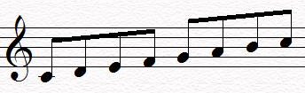

Three Empirical Questions
Consonance/Dissonance
  How well sounds a given interval of tones?
Static Attraction
  What tone fits best for a given scale?
Dynamic Attraction
  What is the best resolution of a chord (e.g. the Tristan Chord)?
Notes:
4

Slide 5
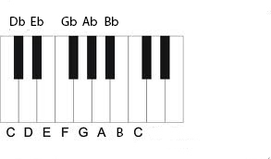
The Attraction Experiment
12 pitch
classes (= tones)
Experiment
  Presentation of tonal context (scale or cadence)
  Presentation of target tone
  Judgment of tonal attraction (how well does the target tone fit into the given context?)
1
3
6
8
10
0
2
4
5
7
9
11
0
Diatonic scale
Notes:
5

Slide 6
Results
C | C♯ | D | E♭ | E | F | F♯ | G | A♭ | A | B♭ | B
C | C♯ | D | E♭ | E | F | F♯ | G | A♭ | A | B♭ | B
major scale (∙ KK data ∙) minor scale
Observations
  the 7 tones of the (diatonic) scale have higher values of tonal attraction than the 5 tones which are not part of the scale
  tones of the tonic triad have higher values than the other tones of the scale
Notes:
6

Slide 7
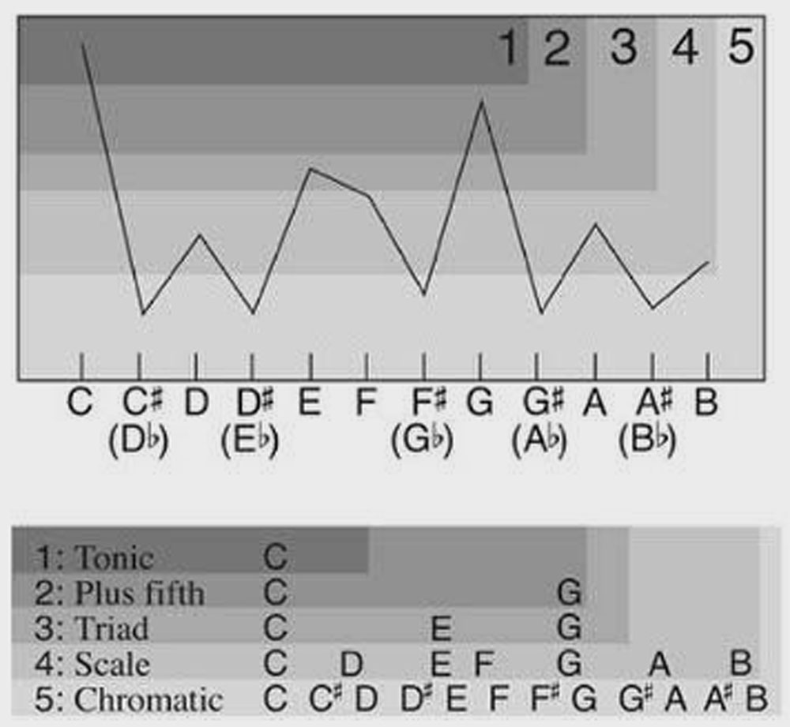
Lerdahl‘s Hierarchic Model of Tonal Pitch Space
The hierarchical model gives a good description of the empirical attraction profiles.
The levels are pure stipulations
Problems with minor scales and non-Western music
Notes:
7

Slide 8
II
The Quantum Model of
Tonal Attraction and Tonal Forces
8
Notes:
8

Slide 9
Symmetry and Invariance
Symmetries in Quantum Physics: “The universe is an enormous direct product of representations of symmetry groups.” S. Weinberg
Symmetries in Quantum Cognition: ???
  Vision (translation invariance)
  Music (transposition invariance)
9
Notes:
9

Slide 10

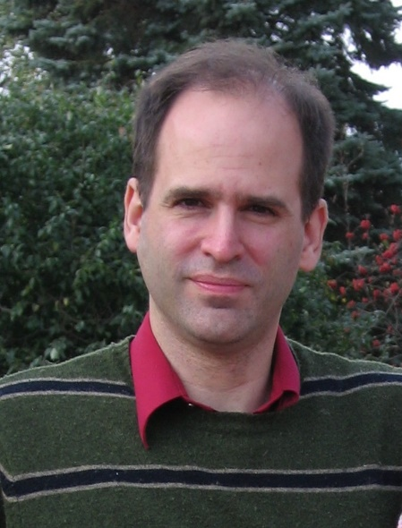
Computational Music Theory
Structural approaches
  E.g. Guerino Mazzola, The Topos of Music
  Music and Symmetry
  Purely structuralist approach without probabilistic elements
Bayesian approaches
  David Temperley, Music and Probability
  Music perception is largely probabilistic in nature
  Where do the probabilities come from?
Quantum theory invites for the combination of both approaches

Slide 11
Qubit states
II.1 The Qubit Approach
A bit is the basic unit of information in classical computation referring to a choice between two discrete states, say {0, 1}.
A qubit is the basic of information in quantum computing referring to a choice between the unit-vectors in a two-dimensional Hilbert space.
For instance, the orthogonal states and can be taken to represent true and false, the vectors in between are appropriate for modeling vagueness.
Notes:
11

Slide 12
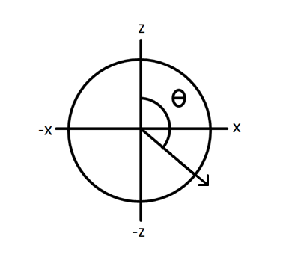
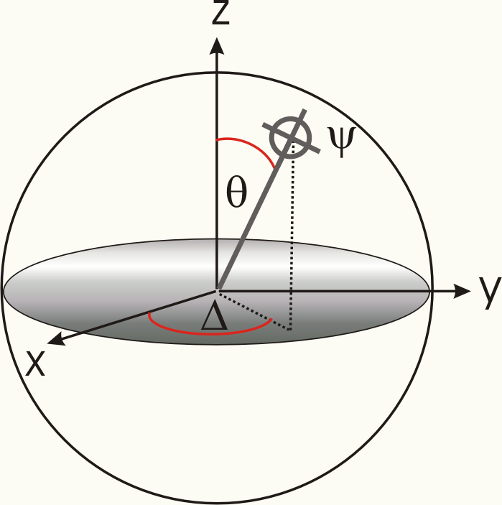
Bloch spheres
Real Hilbert Space:
Complex Hilbert Space
ψ

Slide 13
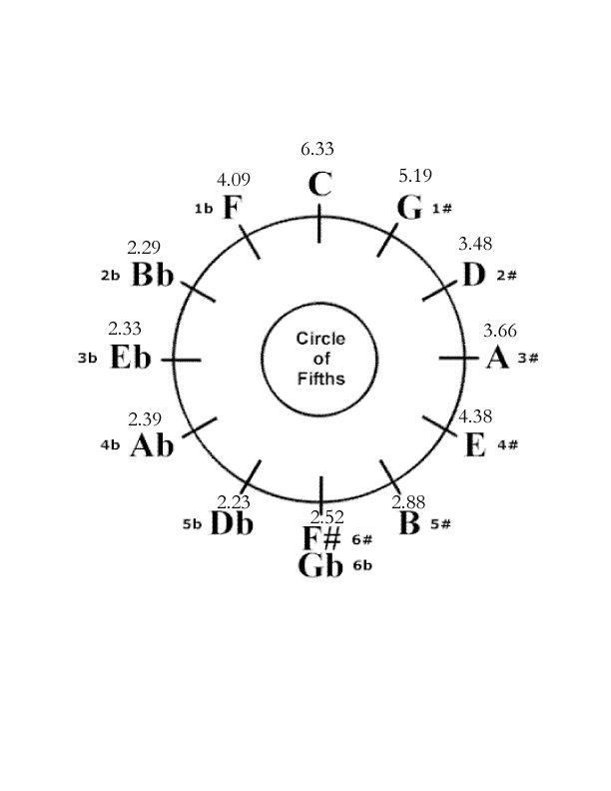
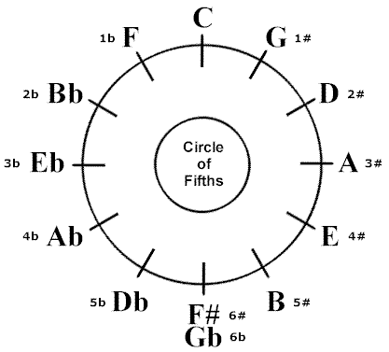

The circle of fifths
z
x
Krumhansl & Kessler 1982:
How well does a pitch fit a given key? (scale from 1-7)

Slide 14
The Cyclic Group
C₁₂
Invariance under transposition
Cyclic groups C_{n}: groups isomorphic to the group of integers modulo n.
12 tones → C₁₂
4 generators of the group:
  x ±1 mod 12 (chromatic circle)
  x±7 mod 12 (circle of fifth)

Slide 15
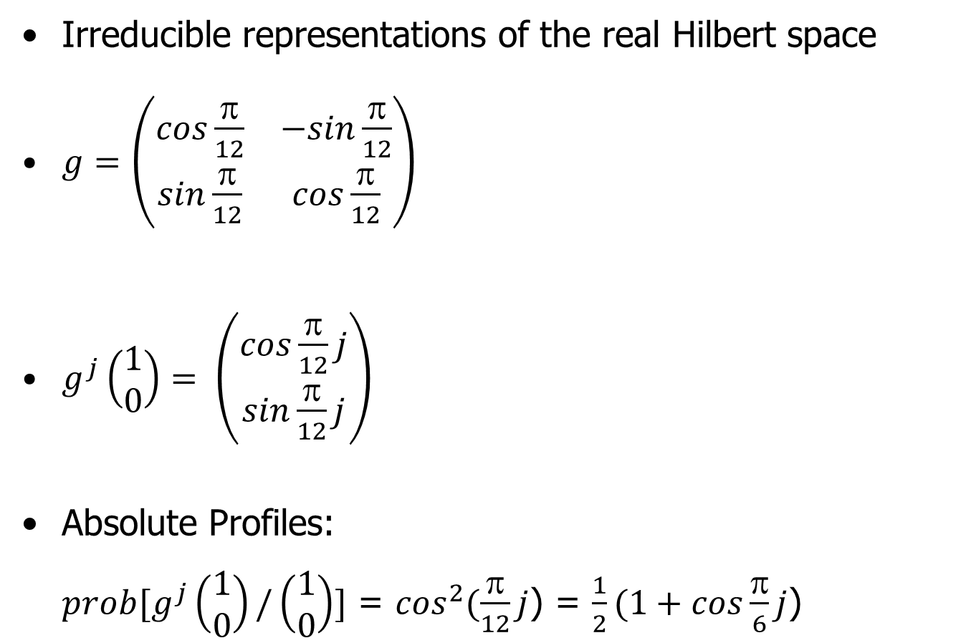

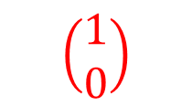
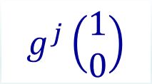
Representation Theory
Irreducible representations of the real Hilbert space
$g=\left(\begin{matrix}cos\frac{π}{12} & −sin\frac{π}{12} \\ sin\frac{π}{12} & cos\frac{π}{12}\end{matrix}\right)$
$g^{j}\left(\begin{matrix}1 \\ 0\end{matrix}\right)= \left(\begin{matrix}cos\frac{π}{12}j \\ sin\frac{π}{12}j\end{matrix}\right)$
Absolute Profiles:
$prob[g^{j}\left(\begin{matrix}1 \\ 0\end{matrix}\right)/\left(\begin{matrix}1 \\ 0\end{matrix}\right)]$ = $\cos^{2}(\frac{π}{12}j$) = $\frac{1}{2}(1+cos\frac{π}{6}j$)
$$g^{j}\left(\begin{matrix}1 \\ 0\end{matrix}\right)$$
$$\left(\begin{matrix}1 \\ 0\end{matrix}\right)$$
${prob = l}^{2}$
Notes:
15

Slide 16
Absolute and Relative Pitch Profiles
Absolute Pitch Profiles
Relative Pitch Profiles
  Given a tonal context (chord, scale, cadence), the pitch profile is calculated by averaging (mixing) over all tones of the context.
Q-Neutral
ICP
Notes:
16

Slide 17
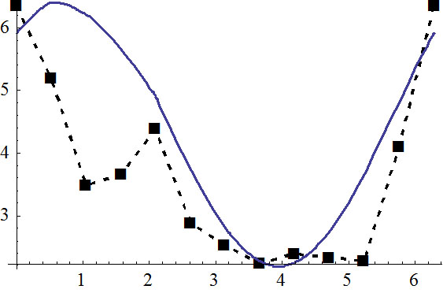

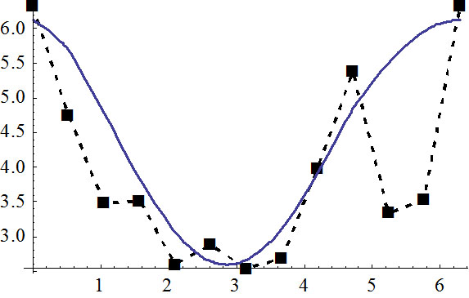

Neutral Case
C Major
r = 0.80
C | G | D | A | E | B | F♯ | C♯ | A♭ | E♭ | B♭ | F
C Minor
r = 0.75
♭
♭
♭
Krumhansl & Kessler 1982
C | G | D | A | E | B | F♯ | C♯ | A♭ | E♭ | B♭ | F

Slide 18
Introducing a Local Variable
II.2 The Gauge Model
Free Schrödinger equation with local variable x
, with Hψ =
Solutions: (plane waves)
  k = ±1/2 (fundamental wave numbers)
  (Möbius type periodic boundary)
Notes:
18

Slide 19
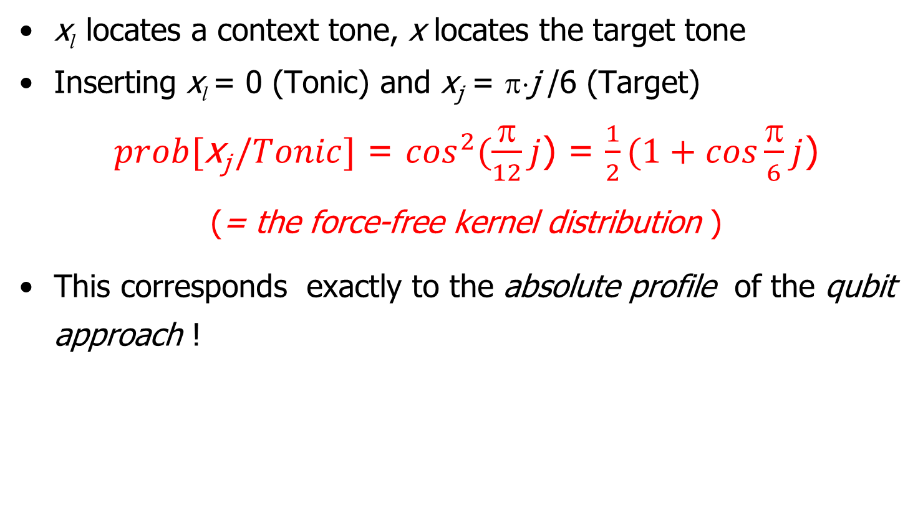
The Force-Free
Kernel Distribution
x_{l} locates a context tone, x locates the target tone
Inserting x_{l} = 0 (Tonic) and x_{j} = π⋅j /6 (Target)
$prob[\text{x}\text{j} /Tonic]$ = $\cos^{2}(\frac{π}{12}j$) = $\frac{1}{2}(1+cos\frac{π}{6}j$)
(= the force-free kernel distribution )
This corresponds exactly to the absolute profile of the qubit approach !
Notes:
19

Slide 20
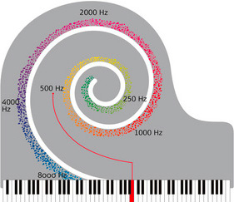
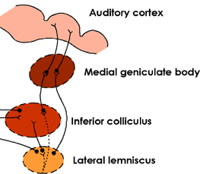
Why the spatial Variable?
Place-Pitch Match (Tonotopical Principle).
  Traveling waves in the cochlea (Georg von Békésy)
  Mapping regions of the cochlea to regions of the auditory cortex
Third generation Neural Network
  Edward Large (based on Hoppensteadt & Izhikevich
  Patrick Suppes, Acacio de Barros, …
Notes:
20

Slide 21
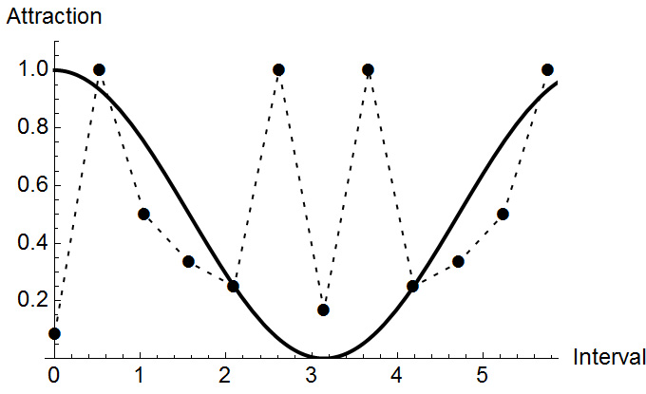
Deformation and Gauge
The spatial deformation
ψ(x) ∼ cos(γ(x))
γ(x) = π/2 + (x-π)⁴/2π³
, with H =T+M+U
Kinetic Energy Magnetic Interaction Potential
Local Gauge Invariance
  Applies under several particular constraints (see full paper)
  musical gauge theory has a broken symmetry that is not the full U(1) symmetry of QED
ICP
Q-Neutral
Q-Forces
Notes:
21

Slide 22
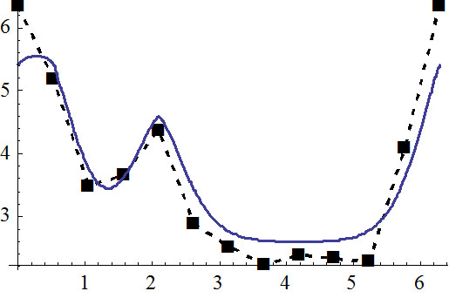
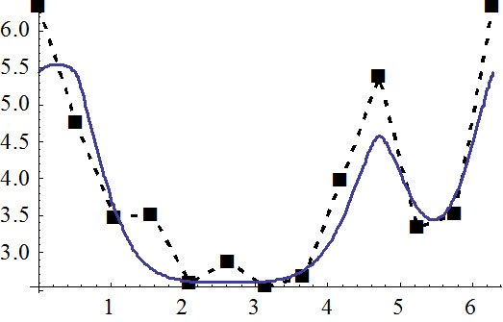
Force Driven Case
C Major
r = 0.97
C | G | D | A | E | B | F♯ | C♯ | A♭ | E♭ | B♭ | F
C Minor
r = 0.93
♭
♭
♭
C | G | D | A | E | B | F♯ | C♯ | A♭ | E♭ | B♭ | F
Krumhansl & Kessler 1982

Slide 23
Musical Micro-Forces
11
0
1
The musical forces produce
deviations from the neutral profile
  One deformation parameter only
  This approach conflicts with the
  metaphoric view (folk physics)
Density function of the total potential energy
  The tonic is an “attractor”
  The tritone is a “magnetic trap”
The kernel function (for a tonic)
  Proportional to the density function
  of the total energy
10
2
9
3
8
4
7
5
6
Notes:
23

Slide 24
Conclusions
Cognitive models of music should integrate structural factors (based on symmetries) with factors of uncertainty (quantum probabilities).
Symmetry and Invariance → Quantum Cognition
The example of tonal attraction shows how a cognitive theory of expectation can be constructed. The quantum gauge model is superior to the traditional models.
  Excellent fit with the data when the force component is included.
New view of innateness
  Innate kernel
  Learned tonal scales
Notes:
24
24

Slide 26
Appendix
26
Notes:
26

Slide 27
Tonal Forces
Larson’s Metaphoric Theory
  Musical force as metaphoric term to describe the phenomena of musical movements (based on ideas of Lakoff & Johnson 1980)
  gravity: the tendency of an unstable note to descend
  magnetism: the tendency to move to the nearest stable pitch
  inertia: the tendency to continue in the same fashion
  Linear Regression method for fitting parameters
Mazzola‘s Interactional Approach (Modulation Quanta)
  It considers musical micro-forces as an emergent concept that arises from the existence of symmetries and invariance principles in music.
  Transforming Schönberg‘s modulation theory in a group theoretic, mathematical model (modulation quanta for the micro-forces)
Notes:
27

Slide 28
Interval Cycles Model (Woolhouse 2009)
Basic idea: the attraction between two pitches is proportional to the number of times the interval spanned by the two pitches must be multiplied by itself to produce some whole number of octaves. → Absolute, key-independent kernel
  C − F♯ (triton): icp = 2 (interval-cycle proximity)
  C − G (fifth) : icp = 12
C | C♯ | D | E♭ | E | F | F♯ | G | A♭ | A | B♭ | B
Notes:
28

Slide 29
Spectral Pitch Class Model
(Milne et al. 2015)
The spectral pitch class vectors for the pitch class F (top) and a major triad CEG (bottom).
  Each tone is represented by its base frequency (smoothed) plus all higher partials (exponentially damped)
  Three (nonlinear) parameters for calculating cosine similarity
Notes:
29

Slide 30
Comparing the Models
Hierarchic Model: The empirical facts are directly stipulated:
  by assuming a "diatonic scale space" (level 4) that includes all scalar notes
  by assuming a higher order "triadic space" (level 3) that includes the tones of the triadic space.
ICP model: The model seeks to derive the basic traits of major/minor attraction profiles, rather than to stipulate them.
  Absolute (key-independent) kernel profile is defined using the ICP
  Context-dependent icps are defined by averaging
Spectral Pitch Class Model: Helmholtzian (acoustic) approach
  Based on the Helmholtzian idea of resonance
  Good empirical fit using three nonlinear parameters
Notes:
30

